Slide 1
Chapter 14a:
Software Architecture

Slide 2
Objectives
To understand the meaning of software architecture, and to discuss why it is important
To explain the goals of software architecture
To understand the different software architecture styles

Slide 3
The Meaning of Software Architecture
An architecture for a software application is its high level design, enabling software engineers to gain understanding
An early stage of the system design process
It involves identifying major system components and their communications
Represents the link between specification and design processes

Slide 4
The Meaning of Software Architecture (Cont’d)
“The architecture of a system is comprehensive framework that describes its form and structure – its components and how they fit together” -- J. Grochow
It is not the operational software, but a representation that enable software engineers to
  Analyze the effectiveness of the design in meeting its stated requirements
  Consider architectural alternatives at a stage when making design changes is still relatively easy
  Reduce the risks associated with the construction of the software

Slide 5
Why Architecture is Important?
Representations of software architecture are an enabler for communication between all parties (stakeholders) interested in the development of a computer-based system.
The architecture highlights early design decisions that will have a profound impact on all software engineering work that follows and, as important, on the ultimate success of the system as an operational entity.
Architecture “constitutes a relatively small, intellectually graspable model of how the system is structured and how its components work together” -- L. Bass

Slide 6
Software Architecture
If the application is small (e.g. 10 classes), this decomposition may be considered as architecture.
Otherwise, we may group the classes into packages, and so
  Software architecture is a decomposition of application into a small number of packages (class collections)
Framework: a collection of classes applicable to multiple applications

Slide 7
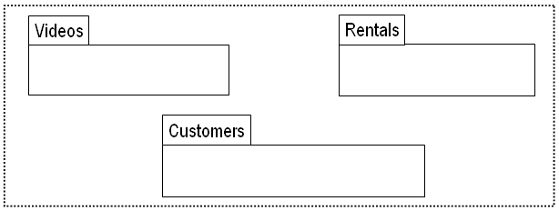
Example: An Architecture for a Video Store Application

Slide 8
Goals for Architecture
Architecture is a design at high level
  Correctness/sufficiency and flexibility
  Other design goals like robustness and efficiency are usually better handled at lower levels of design

Slide 9
Modularization
The principal problem of software systems is complexity.
  It is not hard to write small programs.
Decomposing the problem (modularization) is an effective tool against complexity.
The designer should form a clear mental model of how the application will work at a high level, then develop a decomposition to match the mental model.

Slide 10
Goals of Software Modularization
Cohesion within a module is the degree to which communication takes place among the module’s elements.
Coupling is the degree to which modules depend directly on other modules.
Effective modularization is accomplished by maximizing cohesion and minimizing coupling.

Slide 11
Selecting a Basic Architecture
Develop a mental model of the application.
  As if it were a small application, e.g., personal finance application ...
  “works by receiving money or paying out money, in any order, controlled through a user interface”.
Decompose into the required components.
  Look for high cohesion & low coupling, e.g., personal finance application ...
  decomposes into Assets, Sources, Suppliers, & Interface.
Repeat this process for the components.
Consider using Façade for each package

Slide 12
Example: Personal Finance Application
One decomposition option of personal finance application
  Accounts (checking, savings, etc.)
  Bill paying (electronic, by check, etc.)
  Reports (total assets, liabilities, etc.)
  Loans (car, education, house, etc.)
  Investments (stocks, bonds, etc.)
Alternative decomposition
  Assets (checking accounts, stocks, bonds, etc.)
  Sources ( employers, rental income, etc.)
  Suppliers (landlord, loans, utilities, etc.)
  Interfaces ( user interface, communications interfaces, etc.)

Slide 13
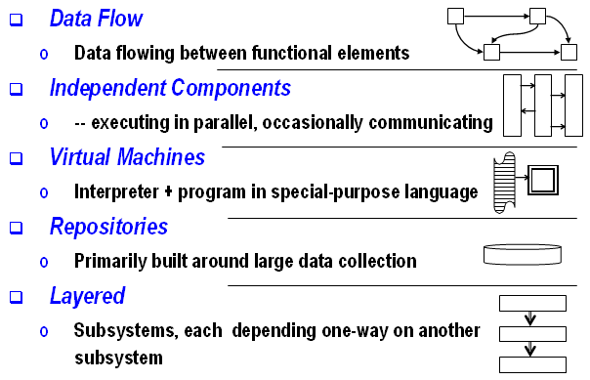
A Classification of Software Architectures

Slide 14
Data Flow Architecture
Functional transformations process their inputs to produce outputs.
May be referred to as a pipe and filter model (as in UNIX shell).
When transformations are sequential, this is a batch sequential model which is extensively used in data processing systems

Slide 15
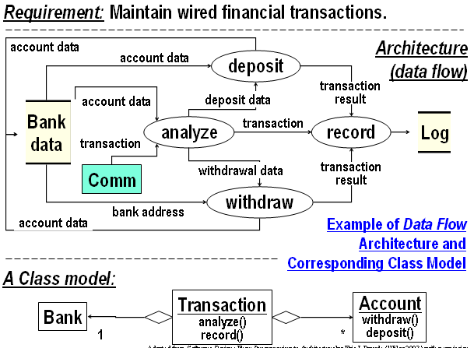
Data Flow Architecture (Cont’d)

Slide 16
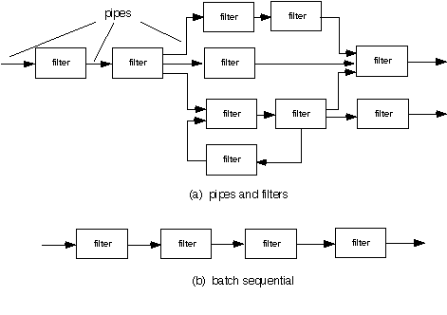
Data Flow Architecture (Cont’d)

Slide 17
Independent Component Architecture
Example: Client-Server Architecture
  Distributed system model which shows how data and processing is distributed across a range of components
  Set of stand-alone servers which provide specific services such as printing, data management, etc.
  Set of clients which call on these services
  Network which allows clients to access servers

Slide 18
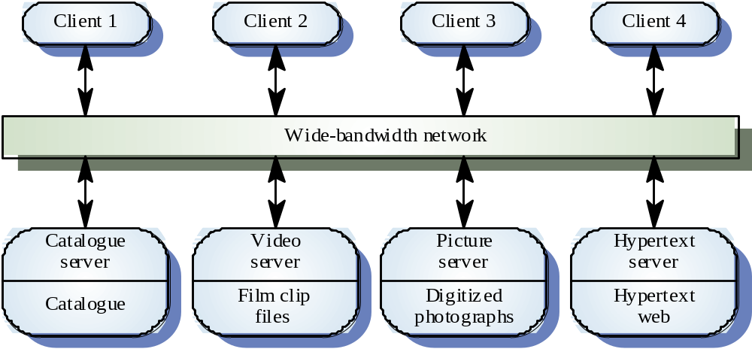
Client-Server Architecture: Example

Slide 19
Client-Server Architecture (Cont’d)
Advantages
  Makes effective use of networked systems. May require cheaper hardware.
  Easy to add new servers or upgrade existing servers.
Disadvantages
  No shared data model so sub-systems use different data organisation. Data interchange may be inefficient.
  Redundant management in each server.
  No central register of names and services - it may be hard to find out what servers and services are available.

Slide 20
Virtual Machine Architecture
A family of applications that are all expressible with a special-purpose high-level language.
  Example: robotic control applications.
The Interpreter design pattern is useful in implementing this architecture.

Slide 21
Repository Architecture
Sub-systems must exchange data. This may be done in two ways:
  Shared data is held in a central database or repository and may be accessed by all sub-systems;
  Each sub-system maintains its own database and passes data explicitly to other sub-systems.
When large amounts of data are to be shared, the repository model of sharing is most commonly used.

Slide 22
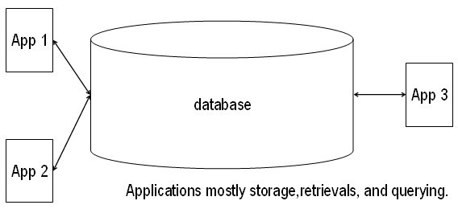
Repository Architecture (Cont’d)

Slide 23
Repository Architecture (Cont’d)
Advantages
  Efficient way to share large amounts of data.
  Sub-systems need not be concerned with how data is produced. Centralised management e.g. backup, security, etc.
Disadvantages
  Sub-systems must agree on a repository data model (schema).
  Data evolution is difficult and expensive.

Slide 24
Layered Architecture
An architectural layer is a coherent collection of software artifacts.
Each layer uses other layers and is used by other layers.
Building applications layer by layer can greatly simplify the implementation process.
However, structuring systems in this way can be difficult.
Sometimes the Template design pattern can be applied.

Slide 25
Common Application Layers
Presentation layer
  Concerned with presenting the results of a computation to system users and with collecting user inputs.
Application processing layer
  Concerned with providing application specific functionality e.g., in a banking system, banking functions such as open account, close account, etc.
Data management layer
  Concerned with managing the system databases.

Slide 26
Other Architectures
Control models: concerned with the control flow between sub-systems.
  Centralised control: one sub-system has overall responsibility for control and starts and stops other sub-systems.
    Example: Call-return model
  Event-based control: each sub-system can respond to externally generated events from other sub-systems or the system’s environment
    Example: Broadcast model

Slide 27
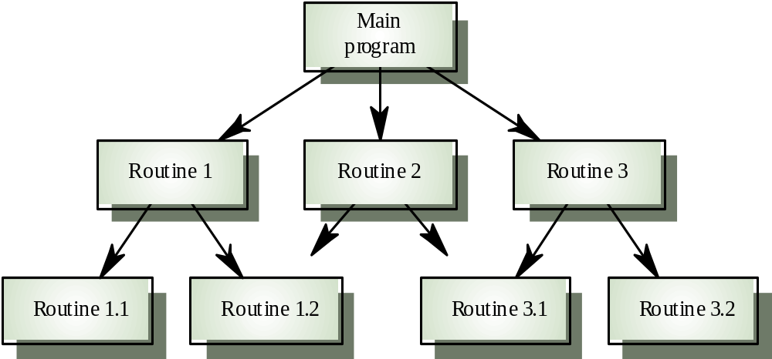
Centralised Control Architecture:
Call-return Model

Slide 28
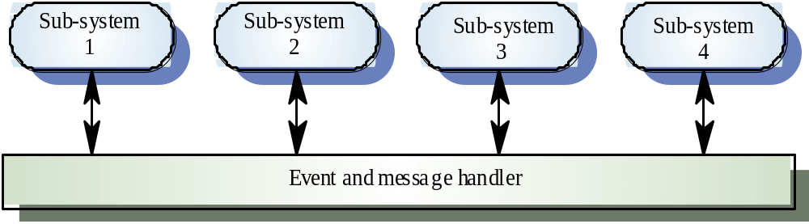
Event-based Control Architecture: Broadcast Model

Slide 29
Summary
A software architectures for a software application is its high level design, enabling software engineers to gain understanding
We want to decompose designs into modules, each well-bind, and depending on few others.
It is important to have an explicit architecture
A number architecture styles exist
Notes:
Acknowledgment: the clip art in these notes are due to Microsoft and Corel Inc.
7.5 Conclusion & Exercises

